Slide 1

SOFTWARE ENGINEERING
By
R.Vignesh,M.E(Ph.D)
Assistant Professor

Slide 2


Slide 3
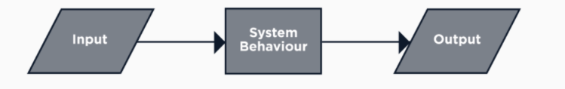
Functional Requirement
Functional requirements define the basic system behaviour.
Essentially, they are what the system does or must not do, and can be thought of in terms of how the system responds to inputs.
Functional requirements usually define behaviours which include calculations, data input, and business processes.
This behavior may be expressed as functions, services or tasks or which system is required to perform.

Slide 4
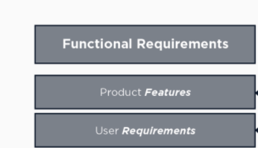
Functional Requirement
In software engineering, a functional requirement defines a system or its component.
It describes the functions a software must perform.

Slide 5
Functional Requirements Documentation:
The Functional Requirements Specification documents the operations and activities that a system must be able to perform.
Functional Requirements should include:
Descriptions of data to be entered into the system
Descriptions of operations performed by each screen
Descriptions of work-flows performed by the system
Descriptions of system reports or other outputs
Who can enter the data into the system
How the system meets applicable regulatory requirements
The Functional Requirements Specification is designed to be read by a general audience.
Readers should understand the system, but no particular technical knowledge should be required to understand the document

Slide 6
Non-Functional Requirement
A non-functional requirement defines the quality attribute of a software system.
They represent a set of standards used to judge the specific operation of a system.
While functional requirements define what the system does or must not do, non-functional requirements specify how the system should do it
Non-functional requirements do not affect the basic functionality of the system (hence the name, non-functional requirements)
Even if the non-functional requirements are not met, the system will still perform its basic purpose.

Slide 7
A non-functional requirement is essential to ensure the usability and effectiveness of the entire software system. Failing to meet non-functional requirements can result in systems that fail to satisfy user needs.
Non-functional Requirements allows you to impose constraints or restrictions on the design of the system across the various agile backlogs.
A website should be capable enough to handle 20 million users with affecting its performance
The software should be portable. So moving from one OS to other OS does not create any problem.
Privacy of information, the export of restricted technologies, intellectual property rights, etc. should be audited.

Slide 8
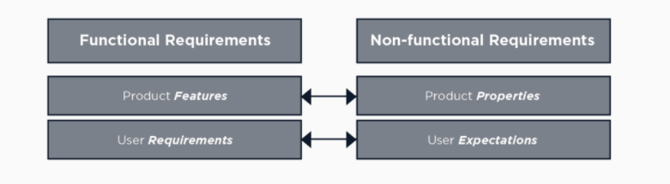
Functional vs Non Functional

Slide 9
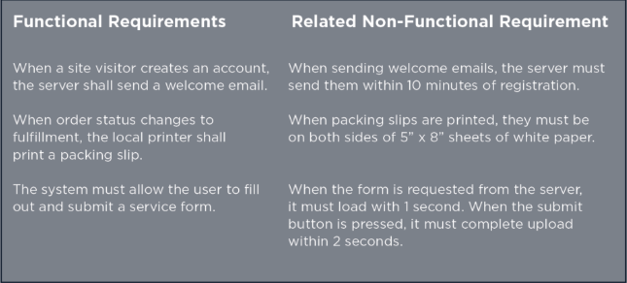
Real time example:

Slide 10
How are functional and non-functional requirements gathered?
One of the best ways to gather requirements is to get all of the stakeholders together for a guided brainstorming session.
Remember that in many cases the upper-level stakeholders are not the users.
Include user representatives on the team, who are one of the best sources for non-functional requirement
As you brainstorm functional requirements, consider these groups:
Business requirements. This usually contains the ultimate goal, such as an order system, an online catalogue, or a physical product. It can also include things like approval workflows and authorization levels.
Administrative functions. These are the routine things the system will do, such as reporting.
User requirements. These are what the user of the system can do, such as place an order or browse the online catalogue.
System requirements. These are things like software and hardware specifications, system responses, or system actions.

Slide 11
After defining the functional requirements, think about the non-functional requirements, such as:
Usability. This focuses on the appearance of the user interface and how people interact with it. What colour are the screens? How big are the buttons?
Reliability / Availability. What are the uptime requirements? Does it need to function 24/7/365?
Scalability. As needs grow, can the system handle it? For physical installations, this includes spare hardware or space to install it in the future.
Performance. How fast does it need to operate?
Supportability. Is support provided in-house or is remote accessibility for external resources required?
Security. What are the security requirements, both for the physical installation and from a cyber perspective?

Slide 12
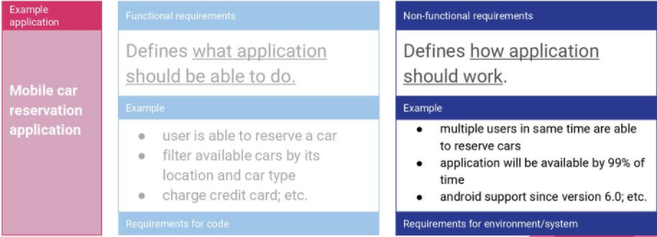

Slide 13
Advantages of Functional Requirement
Here, are the pros/advantages of creating a typical functional requirement document
Helps you to check whether the application is providing all the functionalities that were mentioned in the functional requirement of that application
A functional requirement document helps you to define the functionality of a system or one of its subsystems.
Functional requirements along with requirement analysis help identify missing requirements. They help clearly define the expected system service and behavior.
Errors caught in the Functional requirement gathering stage are the cheapest to fix.
Support user goals, tasks, or activities for easy project management
Functional requirement can be expressed in Use Case form or user story as they exhibit externally visible functional behavior.

Slide 14
Advantages of Non-functional Requirement:
Benefits/pros of Non-functional testing are:
The nonfunctional requirements ensure the software system follow legal and compliance rules.
They ensure the reliability, availability, and performance of the software system
They ensure good user experience and ease of operating the software.
They help in formulating security policy of the software system.

Slide 15
User Requirements
User requirements, often referred to as user needs, describe what the user does with the system, such as what activities that users must be able to perform.
User requirements are generally documented in a User Requirements Document (URD) using narrative text.
User requirements are generally signed off by the user and used as the primary input for creating system requirements.
An important and difficult step of designing a software product is determining what the user actually wants it to do.
This is because the user is often not able to communicate the entirety of their needs and wants, and the information they provide may also be incomplete, inaccurate and self-conflicting.

Slide 16
The responsibility of completely understanding what the customer wants falls on the business analyst.
This is why user requirements are generally considered separately from system requirements.
The business analyst carefully analyzes user requirements and carefully constructs and documents a set of high quality system requirements ensuring that that the requirements meet certain quality characteristics.
A system is said be good if it provides means to use it efficiently. User interface requirements are briefly mentioned below
Content presentation
Easy Navigation
Simple interface
Responsive

Slide 17
Consistent UI elements
Feedback mechanism
Default settings
Purposeful layout
Strategically use of color and texture.
Provide help information
User centric approach
Group based view settings.

Slide 18
System Requirements
System requirements are the building blocks developers use to build the system.
These are the traditional “shall” statements that describe what the system “shall do.”
System requirements are classified as either functional or supplemental requirements.
A functional requirement specifies something that a user needs to perform their work For example, a system may be required to enter and print cost estimates; this is a functional requirement.
Supplemental or non-functional requirements specify all the remaining requirements not covered by the functional requirements.

Slide 19
Supplemental requirements are sometimes called quality of service requirements.
The plan for implementing functional requirements is detailed in the system design.
The plan for implementing supplemental requirements is detailed in the system architecture.
The list below shows various types of supplemental requirements.
Accessibility
Accuracy
Audit, control, and reporting
Availability
Backup and restore
Capacity, current and forecast
Certification etc….

Slide 20
Requirement Engineering:
The process to gather the software requirements from client, analyze and document them is known as requirement engineering.
The goal of requirement engineering is to develop and maintain sophisticated and descriptive ‘System Requirements Specification’ document.
Requirements engineering (RE) refers to the process of defining, documenting, and maintaining requirements in the engineering design process.
Requirement engineering provides the appropriate mechanism to understand what the customer desires, analyzing the need, and assessing feasibility, negotiating a reasonable solution, specifying the solution clearly, validating the specifications and managing the requirements as they are transformed into a working system.
Thus, requirement engineering is the disciplined application of proven principles, methods, tools, and notation to describe a proposed system's intended behavior and its associated constraints.

Slide 21
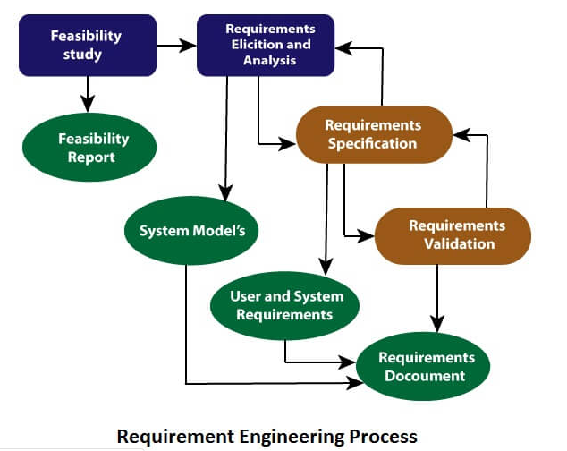
Requirement Engineering Process
It is a four step process, which includes –
Feasibility Study
Requirement Gathering
Software Requirement Specification
Software Requirement Validation

Slide 22
Feasibility study:
The objective behind the feasibility study is to create the reasons for developing the software that is acceptable to users, flexible to change and conformable to established standards.
Types of Feasibility:
Technical Feasibility - Technical feasibility evaluates the current technologies, which are needed to accomplish customer requirements within the time and budget.
Operational Feasibility - Operational feasibility assesses the range in which the required software performs a series of levels to solve business problems and customer requirements.
Economic Feasibility - Economic feasibility decides whether the necessary software can generate financial profits for an organization.

Slide 23
When the client approaches the organization for getting the desired product developed, it comes up with rough idea about what all functions the software must perform and which all features are expected from the software.
Referencing to this information, the analysts does a detailed study about whether the desired system and its functionality are feasible to develop.
This feasibility study is focused towards goal of the organization.
This study analyzes whether the software product can be practically materialized in terms of implementation, contribution of project to organization, cost constraints and as per values and objectives of the organization.
It explores technical aspects of the project and product such as usability, maintainability, productivity and integration ability.

Slide 24
The output of this phase should be a feasibility study report that should contain adequate comments and recommendations for management about whether or not the project should be undertaken.
Requirement Gathering:
If the feasibility report is positive towards undertaking the project, next phase starts with gathering requirements from the user.
Analysts and engineers communicate with the client and end-users to know their ideas on what the software should provide and which features they want the software to include.

Slide 25
Software Requirement Specification
SRS is a document created by system analyst after the requirements are collected from various stakeholders.
SRS defines how the intended software will interact with hardware, external interfaces, speed of operation, response time of system, portability of software across various platforms, maintainability, speed of recovery after crashing, Security, Quality, Limitations etc.
The requirements received from client are written in natural language. It is the responsibility of system analyst to document the requirements in technical language so that they can be comprehended and useful by the software development team.

Slide 26
SRS should come up with following features:
User Requirements are expressed in natural language.
Technical requirements are expressed in structured language, which is used inside the organization.
Design description should be written in Pseudo code.
Format of Forms and GUI screen prints.
Conditional and mathematical notations for DFDs etc.

Slide 27
Software Requirement Validation
After requirement specifications are developed, the requirements mentioned in this document are validated. User might ask for illegal, impractical solution or experts may interpret the requirements incorrectly. This results in huge increase in cost if not nipped in the bud. Requirements can be checked against following conditions:
If they can be practically implemented
If they are valid and as per functionality and domain of software
If there are any ambiguities
If they are complete
If they can be demonstrated

Slide 28
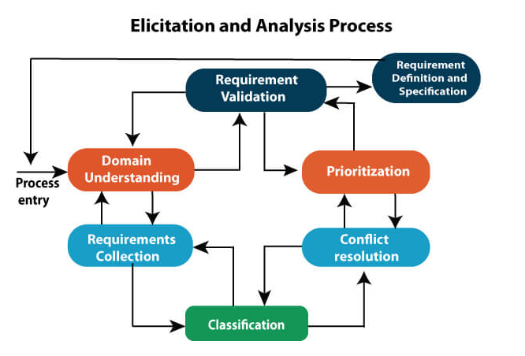

Slide 29
Requirement elicitation process can be depicted using the diagram:
Requirements gathering - The developers discuss with the client and end users and know their expectations from the software.
Organizing Requirements - The developers prioritize and arrange the requirements in order of importance, urgency and convenience.
Negotiation & discussion - If requirements are ambiguous or there are some conflicts in requirements of various stakeholders, if they are, it is then negotiated and discussed with stakeholders. Requirements may then be prioritized and reasonably compromised.
The requirements come from various stakeholders. To remove the ambiguity and conflicts, they are discussed for clarity and correctness. Unrealistic requirements are compromised reasonably.
Documentation - All formal & informal, functional and non-functional requirements are documented and made available for next phase processing.

Slide 30
Requirement Elicitation Techniques
Requirements Elicitation is the process to find out the requirements for an intended software system by communicating with client, end users, system users and others who have a stake in the software system development.
There are various ways to discover requirements
Interviews
Interviews are strong medium to collect requirements. Organization may conduct several types of interviews such as
Structured (closed) interviews, where every single information to gather is decided in advance, they follow pattern and matter of discussion firmly.
Non-structured (open) interviews, where information to gather is not decided in advance, more flexible and less biased.

Slide 31
Oral interviews
Written interviews
One-to-one interviews which are held between two persons across the table.
Group interviews which are held between groups of participants. They help to uncover any missing requirement as numerous people are involved.

Slide 32
Surveys
Organization may conduct surveys among various stakeholders by querying about their expectation and requirements from the upcoming system.
Questionnaires
A document with pre-defined set of objective questions and respective options is handed over to all stakeholders to answer, which are collected and compiled
.
A shortcoming of this technique is, if an option for some issue is not mentioned in the questionnaire, the issue might be left unattended.
Task analysis
Team of engineers and developers may analyze the operation for which the new system is required. If the client already has some software to perform certain operation, it is studied and requirements of proposed system are collected.

Slide 33
Domain Analysis
Every software falls into some domain category. The expert people in the domain can be a great help to analyze general and specific requirements.
Brainstorming
An informal debate is held among various stakeholders and all their inputs are recorded for further requirements analysis.
Prototyping
Prototyping is building user interface without adding detail functionality for user to interpret the features of intended software product.
It helps giving better idea of requirements.

Slide 34
If there is no software installed at client’s end for developer’s reference and the client is not aware of its own requirements, the developer creates a prototype based on initially mentioned requirements.
The prototype is shown to the client and the feedback is noted. The client feedback serves as an input for requirement gathering.
Observation
Team of experts visit the client’s organization or workplace. They observe the actual working of the existing installed systems.
They observe the workflow at client’s end and how execution problems are dealt.
The team itself draws some conclusions which aid to form requirements expected from the software.

Slide 35
Software Requirements Characteristics
Gathering software requirements is the foundation of the entire software development project. Hence they must be clear, correct and well-defined.
A complete Software Requirement Specifications must be:
Clear
Correct
Consistent
Coherent
Comprehensible
Modifiable
Verifiable
Prioritized
Unambiguous
Traceable
Credible source

Slide 36
Validation and Management
Requirements validation is the process of checking that requirements defined for development, define the system that the customer really wants
To check issues related to requirements, we perform requirements validation.
We usually use requirements validation to check error at the initial phase of development as the error may increase excessive rework when detected later in the development process.
In the requirements validation process, we perform a different type of test to check the requirements which include
Completeness checks
Consistency checks
Validity checks
Realism checks
Ambiguity checks
Verifiability

Slide 37
The output of requirements validation is the list of problems and agreed on actions of detected problems.
The lists of problems indicate the problem detected during the process of requirement validation.
The list of agreed action states the corrective action that should be taken to fix the detected problem.
There are several techniques which are used either individually or in conjunction with other techniques to check to check entire or part of the system

Slide 38
Test case generation:
Requirement mentioned in SRS document should be testable, the conducted tests reveal the error present in the requirement.
It is generally believed that if the test is difficult or impossible to design than, this usually means that requirement will be difficult to implement and it should be reconsidered
Prototyping:
In this validation techniques the prototype of the system is presented before the end-user or customer, they experiment with the presented model and check if it meets their need.
This type of model is generally used to collect feedback about the requirement of the user.

Slide 39
Requirements Reviews:
In this approach, the SRS is carefully reviewed by a group of people including people from both the contractor organisations and the client side, the reviewer systematically analyses the document to check error and ambiguity.
Automated Consistency Analysis:
This approach is used for automatic detection of an error, such as nondeterminism, missing cases, a type error, and circular definitions, in requirements specifications.
First, the requirement is structured in formal notation then CASE tool is used to check in-consistency of the system, The report of all inconsistencies is identified and corrective actions are taken.

Slide 40
Walk-through: A walkthrough does not have a formally defined procedure and does not require a differentiated role assignment.
Checking early whether the idea is feasible or not.
Obtaining the opinions and suggestion of other people.
Checking the approval of others and reaching an agreement.

Slide 41
Fundamentals of Requirement Analysis
Requirements analysis process
Requirements Analysis is the process of defining the expectations of the users for an application that is to be built or modified.
Requirements analysis involves all the tasks that are conducted to identify the needs of different stakeholders.
Therefore requirements analysis means to analyze, document, validate and manage software or system requirements.
High-quality requirements are documented, actionable, measurable, testable, traceable, helps to identify business opportunities, and are defined to a facilitate system design.

Slide 42
Requirements Analysis process
The requirements analysis process involves the following steps:
Eliciting requirements.The process of gathering requirements by communicating with the customers is known as eliciting requirements
Analyzing requirements
This step helps to determine the quality of the requirements. It involves identifying whether the requirements are unclear, incomplete, ambiguous, and contradictory. These issues resolved before moving to the next step.
Requirements modeling
In Requirements modeling, the requirements are usually documented in different formats such as use cases, user stories, natural-language documents, or process specification.

Slide 43
Review and retrospective
This step is conducted to reflect on the previous iterations of requirements gathering in a bid to make improvements in the process going forward.
Requirements Analysis Techniques
There are different techniques used for Requirements Analysis. Below is a list of different Requirements Analysis Techniques:
Business process modeling notation (BPMN)
This technique is similar to creating process flowcharts, although BPMN has its own symbols and elements.
Business process modeling and notation is used to create graphs for the business process. These graphs simplify understanding the business process.
BPMN is widely popular as a process improvement methodology.

Slide 44
UML (Unified Modeling Language)
UML consists of an integrated set of diagrams that are created to specify, visualize, construct and document the artifacts of a software system.
UML is a useful technique while creating object-oriented software and working with the software development process.
In UML, graphical notations are used to represent the design of a software project.
UML also help in validating the architectural design of the software.

Slide 45
Flowchart technique
A flowchart depicts the sequential flow and control logic of a set of activities that are related.
Flowcharts are in different formats such as linear, cross-functional, and top-down.
The flowchart can represent system interactions, data flows, etc.
Flow charts are easy to understand and can be used by both the technical and non-technical team members.
Flowchart technique helps in showcasing the critical attributes of a process.

Slide 46
Data flow diagram
This technique is used to visually represent systems and processes that are complex and difficult to describe in text.
Data flow diagrams represent the flow of information through a process or a system.
It also includes the data inputs and outputs, data stores, and the various sub process through which the data moves.
DFD describes various entities and their relationships with the help of standardized notations and symbols.
By visualizing all the elements of the system it is easier to identify any shortcomings.
These shortcomings are then eliminated in a bid to create a robust solution.

Slide 47
Gantt Charts
Gantt charts used in project planning as they provide a visual representation of tasks that are scheduled along with the timelines.
The Gantt charts help to know what is scheduled to be completed by which date.
The start and end dates of all the tasks in the project can be seen in a single view.
Gap Analysis
Gap analysis is a technique which helps to analyze the gaps in performance of a software application to determine whether the business requirements are met or not.
It also involves the steps that are to be taken to ensure that all the business requirements are met successfully.
Gap denotes the difference between the present state and the target state.
Gap analysis is also known as need analysis, need assessment or need-gap analysis.

Slide 48
Structured System Analysis
Structured Analysis
It is a development method that allows the analyst to understand the system and its activities in a logical way.
It is a systematic approach, which uses graphical tools that analyze and refine the objectives of an existing system and develop a new system specification which can be easily understandable by user.
It has following attributes
It is graphic which specifies the presentation of application.
It divides the processes so that it gives a clear picture of system flow.
It is logical rather than physical i.e., the elements of system do not depend on vendor or hardware.
It is an approach that works from high-level overviews to lower-level details.

Slide 49
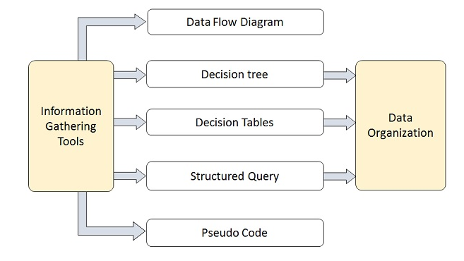
Structured Analysis Tools
During Structured Analysis, various tools and techniques are used for system development. They are
Data Flow Diagrams
Data Dictionary
Decision Trees
Decision Tables
Structured English
Pseudocode

Slide 50
Data Flow Diagrams (DFD) or Bubble Chart
It is a technique developed by Larry Constantine to express the requirements of system in a graphical form.
It shows the flow of data between various functions of system and specifies how the current system is implemented.
It is an initial stage of design phase that functionally divides the requirement specifications down to the lowest level of detail.
Its graphical nature makes it a good communication tool between user and analyst or analyst and system designer.
It gives an overview of what data a system processes, what transformations are performed, what data are stored, what results are produced and where they flow.

Slide 51
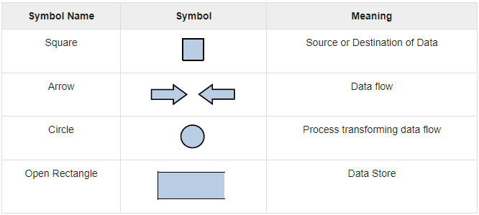
Basic Elements of DFD
DFD is easy to understand and quite effective when the required design is not clear and the user wants a notational language for communication.
However, it requires a large number of iterations for obtaining the most accurate and complete solution.
The following table shows the symbols used in designing a DFD and their significance

Slide 52
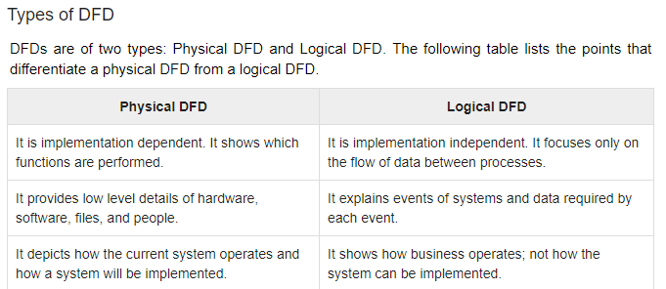

Slide 53
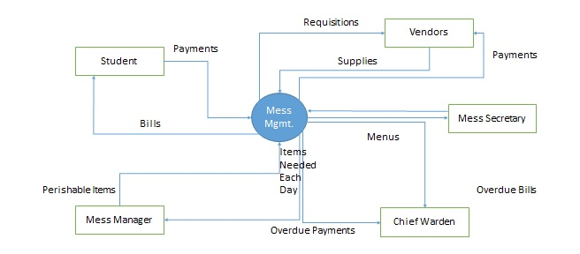
Context Diagram
A context diagram helps in understanding the entire system by one DFD which gives the overview of a system.
It starts with mentioning major processes with little details and then goes onto giving more details of the processes with the top-down approach.
The context diagram of mess management is shown below

Slide 54
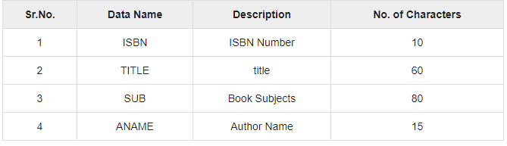
Data Dictionary
A data dictionary is a structured repository of data elements in the system.
It stores the descriptions of all DFD data elements that is, details and definitions of data flows, data stores, data stored in data stores, and the processes.
A data dictionary improves the communication between the analyst and the user. It plays an important role in building a database.
Most DBMSs have a data dictionary as a standard feature. For example, refer the following table

Slide 55
Decision Trees
Decision trees are a method for defining complex relationships by describing decisions and avoiding the problems in communication.
A decision tree is a diagram that shows alternative actions and conditions within horizontal tree framework.
Thus, it depicts which conditions to consider first, second, and so on.
Decision trees depict the relationship of each condition and their permissible actions.
A square node indicates an action and a circle indicates a condition.
It forces analysts to consider the sequence of decisions and identifies the actual decision that must be made.

Slide 56
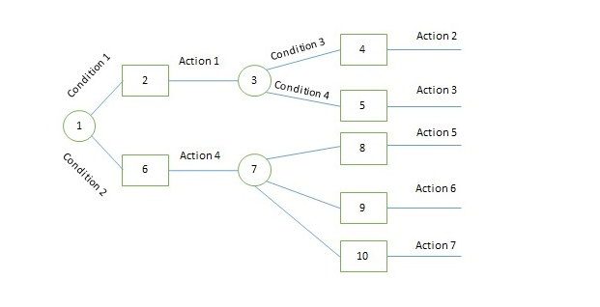
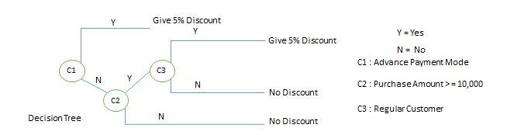
The major limitation of a decision tree is that it lacks information in its format to describe what other combinations of conditions you can take for testing. It is a single representation of the relationships between conditions and actions.
For example, refer the following decision tree

Slide 57
Decision Tables
Decision tables are a method of describing the complex logical relationship in a precise manner which is easily understandable.
It is useful in situations where the resulting actions depend on the occurrence of one or several combinations of independent conditions.
It is a matrix containing row or columns for defining a problem and the actions.
Components of a Decision Table
Condition Stub − It is in the upper left quadrant which lists all the condition to be checked.
Action Stub − It is in the lower left quadrant which outlines all the action to be carried out to meet such condition.
Condition Entry − It is in upper right quadrant which provides answers to questions asked in condition stub quadrant.
Action Entry − It is in lower right quadrant which indicates the appropriate action resulting from the answers to the conditions in the condition entry quadrant.

Slide 58
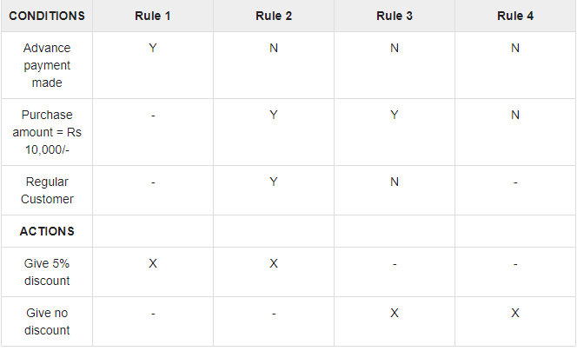
The entries in decision table are given by Decision Rules which define the relationships between combinations of conditions and courses of action. In rules section,
Y shows the existence of a condition.
N represents the condition, which is not satisfied.
A blank - against action states it is to be ignored.
X (or a check mark will do) against action states it is to be carried out.
For example, refer the following table

Slide 59
Software Prototyping
Prototype methodology is defined as a Software Development model in which a prototype is built, test, and then reworked when needed until an acceptable prototype is achieved.
It also creates a base to produce the final system.
Software prototyping model works best in scenarios where the project's requirement are not known.
It is an iterative, trial, and error method which take place between the developer and the client

Slide 60
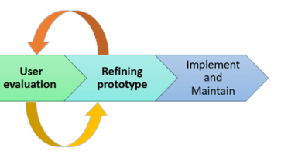


Slide 61
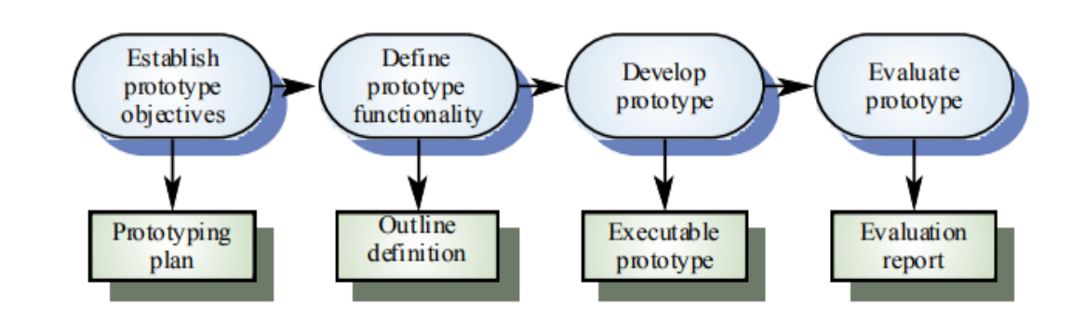

Slide 62
Phases
Prototyping Model has following six SDLC phases as follow:
Step 1: Requirements gathering and analysis
A prototyping model starts with requirement analysis. In this phase, the requirements of the system are defined in detail. During the process, the users of the system are interviewed to know what is their expectation from the system.
Step 2: Quick design
The second phase is a preliminary design or a quick design. In this stage, a simple design of the system is created. However, it is not a complete design. It gives a brief idea of the system to the user. The quick design helps in developing the prototype.
Step 3: Build a Prototype
In this phase, an actual prototype is designed based on the information gathered from quick design. It is a small working model of the required system.

Slide 63
Step 4: Initial user evaluation
In this stage, the proposed system is presented to the client for an initial evaluation. It helps to find out the strength and weakness of the working model. Comment and suggestion are collected from the customer and provided to the developer.
Step 5: Refining prototype
If the user is not happy with the current prototype, you need to refine the prototype according to the user's feedback and suggestions.This phase will not over until all the requirements specified by the user are met. Once the user is satisfied with the developed prototype, a final system is developed based on the approved final prototype.
Step 6: Implement Product and Maintain
Once the final system is developed based on the final prototype, it is thoroughly tested and deployed to production. The system undergoes routine maintenance for minimizing downtime and prevent large-scale failures.

Slide 64
Types of Prototyping Models
Four types of Prototyping models are:
Rapid Throwaway prototypes
Evolutionary prototype
Incremental prototype
Extreme prototype
Rapid Throwaway Prototype
Rapid throwaway is based on the preliminary requirement. It is quickly developed to show how the requirement will look visually. The customer's feedback helps drives changes to the requirement, and the prototype is again created until the requirement is baselined.
In this method, a developed prototype will be discarded and will not be a part of the ultimately accepted prototype. This technique is useful for exploring ideas and getting instant feedback for customer requirements.

Slide 66
Evolutionary Prototyping
Here, the prototype developed is incrementally refined based on customer's feedback until it is finally accepted.
It helps you to save time as well as effort.
That's because developing a prototype from scratch for every interaction of the process can sometimes be very frustrating.
This model is helpful for a project which uses a new technology that is not well understood.
It is also used for a complex project where every functionality must be checked once.
It is helpful when the requirement is not stable or not understood clearly at the initial stage.

Slide 68
Incremental Prototyping
In incremental Prototyping, the final product is decimated into different small prototypes and developed individually.
Eventually, the different prototypes are merged into a single product.
This method is helpful to reduce the feedback time between the user and the application development team.
Extreme Prototyping:
Extreme prototyping method is mostly used for web development. It is consists of three sequential phases.
Basic prototype with all the existing page is present in the HTML format.
You can simulate data process using a prototype services layer.
The services are implemented and integrated into the final prototype.

Slide 70
Best practices of Prototyping
Here, are a few things which you should watch for during the prototyping process:
You should use Prototyping when the requirements are unclear
It is important to perform planned and controlled Prototyping.
Regular meetings are vital to keep the project on time and avoid costly delays.
The users and the designers should be aware of the prototyping issues and pitfalls.
At a very early stage, you need to approve a prototype and only then allow the team to move to the next step.
In software prototyping method, you should never be afraid to change earlier decisions if new ideas need to be deployed.
You should select the appropriate step size for each version.
Implement important features early on so that if you run out of the time, you still have a worthwhile system

Slide 71
Advantages:
Here, are important pros/benefits of using Prototyping models:
Users are actively involved in development. Therefore, errors can be detected in the initial stage of the software development process.
Missing functionality can be identified, which helps to reduce the risk of failure as Prototyping is also considered as a risk reduction activity.
Helps team member to communicate effectively
Customer satisfaction exists because the customer can feel the product at a very early stage.
There will be hardly any chance of software rejection.
Quicker user feedback helps you to achieve better software development solutions.

Slide 72
cons/drawbacks of prototyping model:
Prototyping is a slow and time taking process.
The cost of developing a prototype is a total waste as the prototype is ultimately thrown away.
Prototyping may encourage excessive change requests.
Some times customers may not be willing to participate in the iteration cycle for the longer time duration.
There may be far too many variations in software requirements when each time the prototype is evaluated by the customer.
Poor documentation because the requirements of the customers are changing.
It is very difficult for software developers to accommodate all the changes demanded by the clients.
After seeing an early prototype model, the customers may think that the actual product will be delivered to him soon.
The client may lose interest in the final product when he or she is not happy with the initial prototype.
Developers who want to build prototypes quickly may end up building sub-standard development solutions.

Slide 73
Data modeling:
Data modeling (data modeling) is the process of creating a data model for the data to be stored in a Database.
This data model is a conceptual representation of Data objects, the associations between different data objects and the rules.
Data modeling helps in the visual representation of data and enforces business rules, regulatory compliances, and government policies on the data.
Data Models ensure consistency in naming conventions, default values, semantics, security while ensuring quality of the data.

Slide 74
Data model emphasizes on what data is needed and how it should be organized instead of what operations need to be performed on the data.
Data Model is like architect's building plan which helps to build a conceptual model and set the relationship between data items.
The two types of Data Models techniques are
Entity Relationship (E-R) Model
UML (Unified Modelling Language)
Goal of Data Model:
The primary goal of using data model are:
Ensures that all data objects required by the database are accurately represented. Omission of data will lead to creation of faulty reports and produce incorrect results.

Slide 75
A data model helps design the database at the conceptual, physical and logical levels.
Data Model structure helps to define the relational tables, primary and foreign keys and stored procedures.
It provides a clear picture of the base data and can be used by database developers to create a physical database.
It is also helpful to identify missing and redundant data.
Though the initial creation of data model is labor and time consuming, in the long run, it makes your IT infrastructure upgrade and maintenance cheaper and faster.

Slide 76
Types of Data Models
There are mainly three different types of data models:
Conceptual: This Data Model defines WHAT the system contains. This model is typically created by Business stakeholders and Data Architects. The purpose is to organize, scope and define business concepts and rules.
Logical: Defines HOW the system should be implemented regardless of the DBMS. This model is typically created by Data Architects and Business Analysts. The purpose is to developed technical map of rules and data structures.
Physical: This Data Model describes HOW the system will be implemented using a specific DBMS system. This model is typically created by DBA and developers. The purpose is actual implementation of the database.

Slide 77
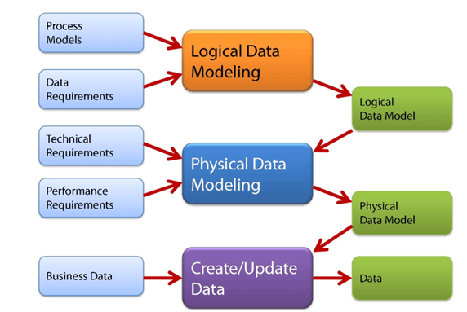

Slide 78
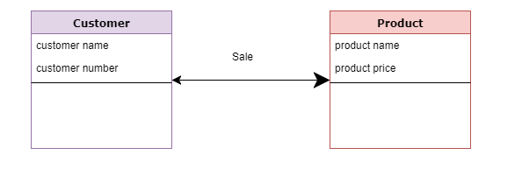
Conceptual Model
The main aim of this model is to establish the entities, their attributes, and their relationships.
In this Data modeling level, there is hardly any detail available of the actual Database structure.
The 3 basic tenants of Data Model are
Entity: A real-world thing
Attribute: Characteristics or properties of an entity
Relationship: Dependency or association between two entities
For example:
Customer and Product are two entities. Customer number and name are attributes of the Customer entity
Product name and price are attributes of product entity
Sale is the relationship between the customer and product

Slide 79
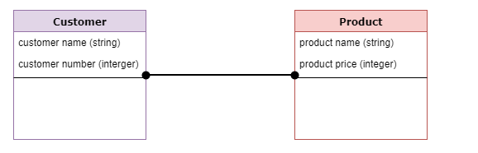
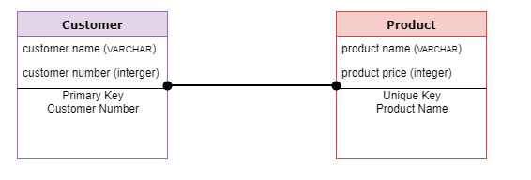
Logical Data Model
Logical data models add further information to the conceptual model elements. It defines the structure of the data elements and set the relationships between them
Physical Data Model
A Physical Data Model describes the database specific implementation of the data model.
It offers an abstraction of the database and helps generate schema.
This is because of the richness of meta-data offered by a Physical Data Model.

Slide 80
Behavioural Model :
All behavioural models really do is describe the control structure of a system. This can be things like:
Sequence of operations
Object states
and Object interactions
Furthermore, this modelling layer can also be called Dynamic Modelling. The activity of creating a behavioural model is commonly known as behavioural modelling.
As well as this, a system should also only have one behavioural model – much like functional modelling.
Representation:
we represent them with dynamic diagrams. For example:
(Design) Sequence Diagrams
Communication Diagrams or collaboration diagram
State Diagrams or state machine diagram or state chart

Slide 81
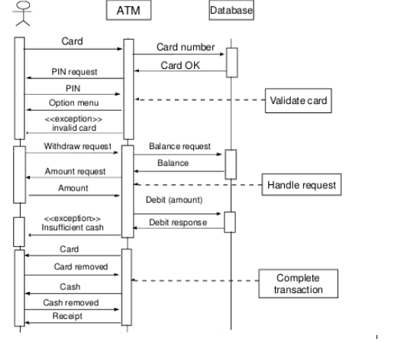
For consistency use communication diagram and state diagram
If we have both a sequence diagram and communication diagram, then together these are known as interaction diagrams, this is because they both represent how objects interact with one another using messages.
Description:
A behavioural model describes when the system is changing.
The key feature (subject) of a behavioural model is – Objects.

Slide 82
Data Dictionaries
A data dictionary is a file or a set of files that includes a database's metadata.
The data dictionary hold records about other objects in the database, such as data ownership, data relationships to other objects, and other data.
The data dictionary is an essential component of any relational database.
Ironically, because of its importance, it is invisible to most database users. Typically, only database administrators interact with the data dictionary

Slide 83
The data dictionary, in general, includes information about the following:
Name of the data item
The name of the data item is self-explanatory.
Aliases
Aliases include other names by which this data item is called DEO for Data Entry Operator and DR for Deputy Registrar.
Description/purpose
Description/purpose is a textual description of what the data item is used for or why it exists.
Related data items
Related data items capture relationships between data items e.g., total_marks must always equal to internal_marks plus external_marks.

Slide 84
Range of values
Range of values records all possible values, e.g. total marks must be positive and between 0 to 100.
Data structure definition/Forms
Data flows capture the name of processes that generate or receive the data items.
If the data item is primitive, then data structure form captures the physical structures of the data item.
If the data is itself a data aggregate, then data structure form capture the composition of the data items in terms of other data items.

Slide 85
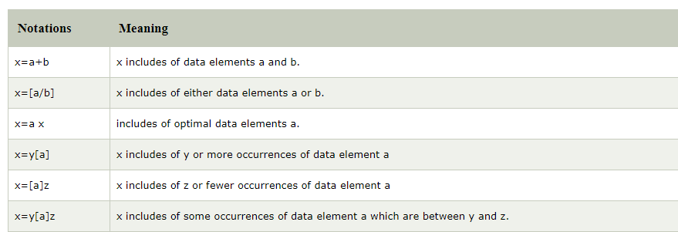
The mathematical operators used within the data dictionary are defined in the table

Slide 86
Uses of Data Dictionary:
Create an ordered listing of all data items.
Create an ordered listing of a subset of data item.
Find a data item name from a description.
Design a software and test cases.

Slide 87
Thank you

